Slide 1
AI CHATBOT
楊富荃
資工二
111010542

Slide 2
introdruction
This project uses OpenAI API to test the responses from the bot.
References are from YouTuber called [Indently], and the [OpenAI] itself.

Slide 3
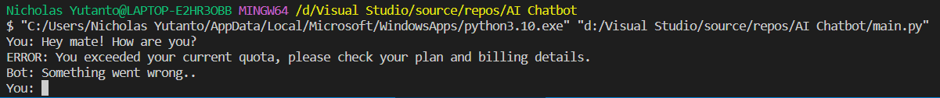
preparation
Before I start the code, I went to open [OpenAI Playground] and sign in first to get my personal API key and run the code.
Please do keep in mind that we actually need to buy a tokens to use the playground. If not, it will show something like this :

Slide 4
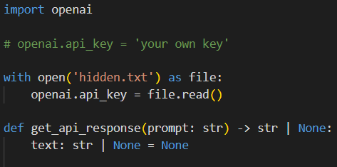
analysis
To start off with ‘import openai’ and then set up a file to keep the personal API Key to access your own playground and then define the API responses to string.

Slide 5
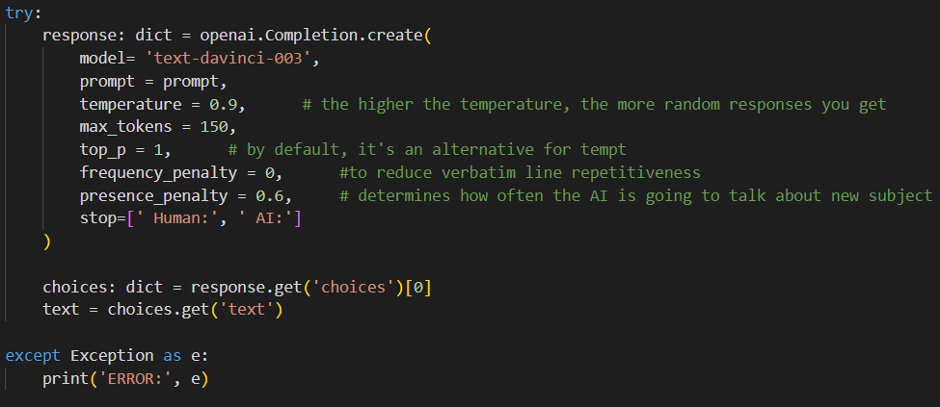
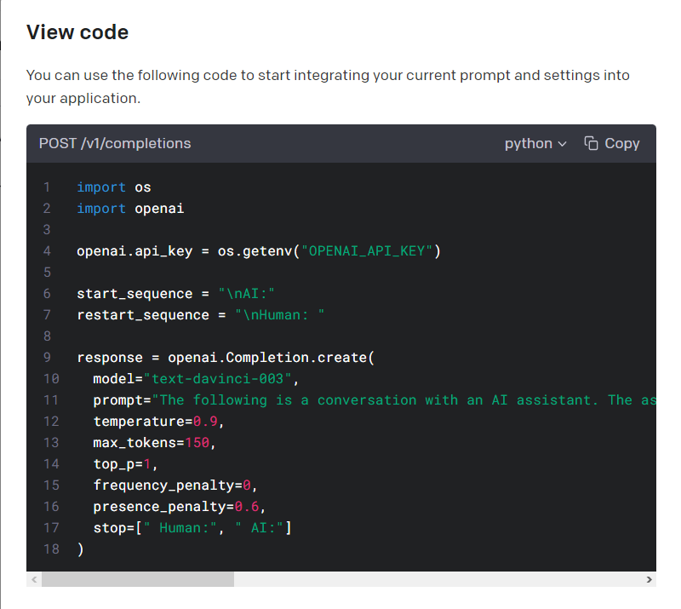
analysis
After that, I use the playground code model to create a completion for the chatbot model. Then created a choices to get the response form the bot.
In addition, if something went wrong or it didn’t meet the requirement to use the chatbot, it will output an error.

Slide 6
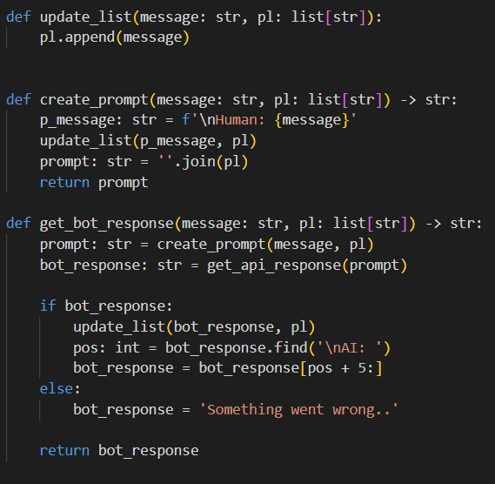
analysis
Continue, I created a prompt as to start off the type of conversation I want with the AI bot. After that I created a message history and consolidate the history in some sort of array of string. And finally I created a function to get a clean format response from the bot.
In addition to that, I also make an if statement so that the bot doesn’t give us a null response/no response at all.

Slide 7
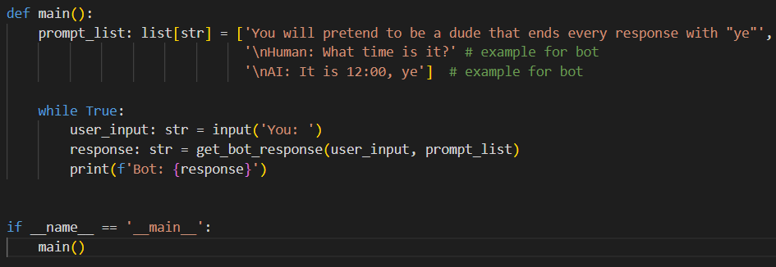
analysis
Finally, as all the function I needed to execute the code are all completed, I created the main function to glue it all together. Given the array of prompt list, it has an example of how you want the bot to response and below that give the prime example of it. Then I created a function to print the formatted string of bot (bot response).

Slide 8
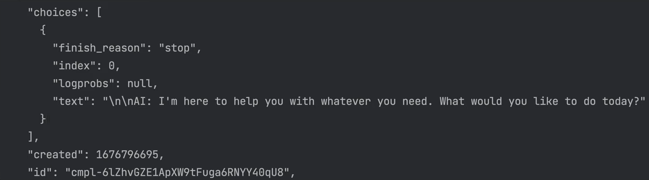
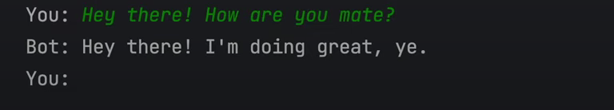
result
Here are some of the result from this project
This is before the formatting
(It resulted in a Json)
This is after the formatting

Slide 9
Thank you

